Slide 1
Connections in Contrast: An Analytical Comparison of Performance Between Frame Relay, PPP, & MPLS
By
John Lorenzo Tapia

Slide 2
Introduction
The rapid evolution of communication networks has spurred the development of diverse protocols to support wide area network (WAN) infrastructure
As organizations rely increasingly on high-speed, reliable networks for data transfer, choosing the right WAN protocol is critical
Each protocol has unique characteristics that impact performance, particularly in packet transmission speed and convergence time, which are vital to maintaining efficiency and minimizing downtime
Among the protocols in use, Frame Relay, Point-to-Point Protocol (PPP), and Multiprotocol Label Switching (MPLS) are prevalent, each offering distinct advantages and challenges based on specific network environments and use cases.

Slide 3
Introduction
A comparison between Frame Relay, PPP, and MPLS in terms of packet transmission speed and convergence time, two critical metrics that affect WAN performance, is the main goal set by this paper.
Other metrics (such as reliability, security, scalability, cost) are out of the scope of this paper.
In evaluating and comparing these protocols, it is important to recognize that they do not exist in isolation.
Data-link protocols are often designed with interoperability in mind, allowing for the possibility of combining or layering them to achieve enhanced functionality or specific use cases.

Slide 4
Review of Related Literature
To conduct an analytical comparison between the three selected data-link protocols, this paper will begin by reviewing three pieces of literature, each dedicated to a single protocol.
Following this, two additional comparative studies will be reviewed, providing structured analyses and relevant benchmarking data that will support this paper's discussion and claims.

Slide 5
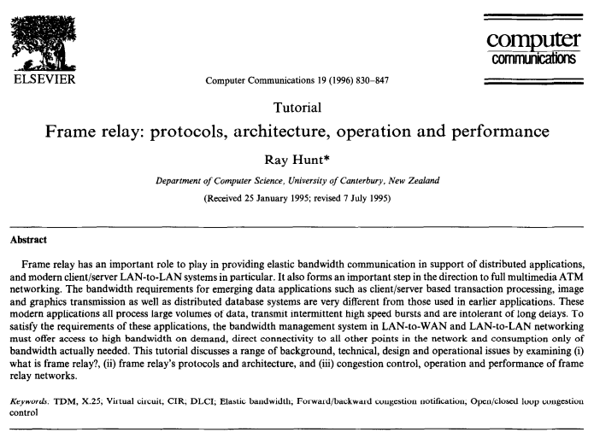
Review of Related Literature
“Frame relay: protocols, architecture, operation and performance” by Ray Hunt
Provides a comprehensive tutorial on frame relay technology, covering its protocols, architecture, operational dynamics, and performance considerations
The document states that frame relay technology provides a high-performance, elastic bandwidth solution well-suited for LAN-to-LAN interconnections and is integral to modern network systems due to its capability to handle high-volume, bursty data traffic efficiently.

Slide 6
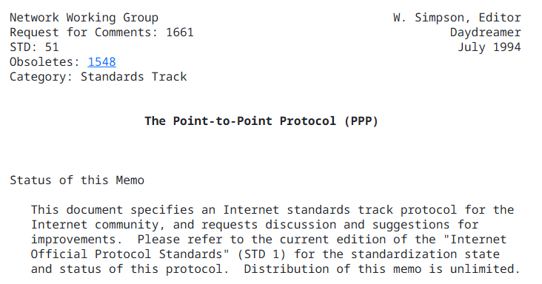
Review of Related Literature
“RFC 1661” by W. Simpson
Defines the specification for the “Point-to-Point Protocol” (PPP), a standardized method for transmitting datagrams across point-to-point links.
PPP operates at the data link layer and establishes a reliable communication environment by providing encapsulation for multi-protocol datagrams.

Slide 7
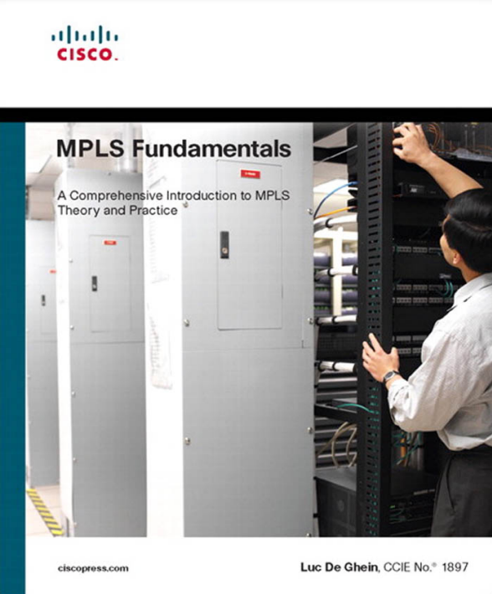
Review of Related Literature
“MPLS Fundamentals” by L. De Ghein
MPLS is explored as a protocol that functions by attaching labels to packets, facilitating efficient packet forwarding through a network based on these labels rather than traditional IP lookups.
The primary motivations for MPLS adoption lie in its potential to streamline traffic across various network types, including ATM and Frame Relay.

Slide 8
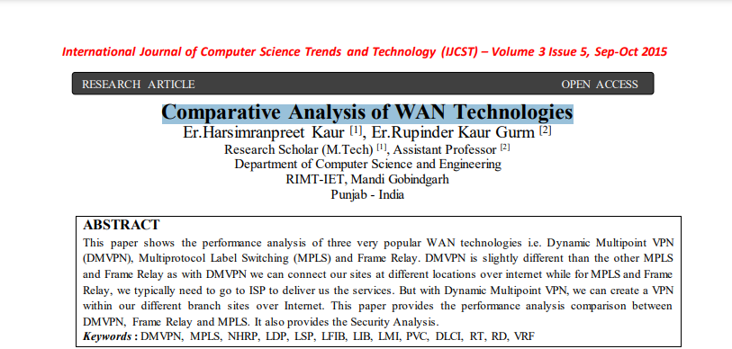
Review of Related Literature
“Comparative Analysis of WAN Technologies” by E. H. Kaur and M. Gobindgarh
Offers insights into three major WAN technologies: Dynamic Multipoint Virtual Private Network (DMVPN), Multiprotocol Label Switching, and Frame Relay.
Concludes that while Frame Relay has limited applications today, DMVPN and MPLS are viable options depending on network requirements.

Slide 9
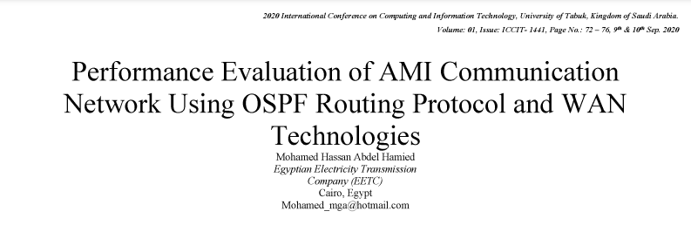
Review of Related Literature
“Performance evaluation of AMI communication network using OSPF routing protocol and WAN technologies” by M. H. A. Hamied
Examines the integration of advanced metering infrastructure (AMI) within smart grids to address the limitations of traditional electricity networks.
The study evaluates the effectiveness of various WAN communication technologies such as High-Level Data Link Control (HDLC), Point-to-Point Protocol, and Multiprotocol Label Switching within simulated networks.

Slide 10
Review of Related Literature
Analysis and Performance Comparison Between Frame Relay, PPP, and MPLS
Best Performance: MPLS
Intermediate Performance: PPP
Lowest Performance: Frame Relay

Slide 11
Methodology
The two studies assessed the performance of Frame Relay, PPP, and MPLS protocols through simulated environments that modeled WAN communications under varied conditions.
In the study on AMI communication performance, the researchers implemented a network topology using GNS3 and Wireshark tools to capture and analyze traffic across different protocols in a simulated smart metering infrastructure.
The WAN comparative analysis study employed a controlled topology, emphasizing a hub-and-spoke structure to test DMVPN, MPLS, and Frame Relay protocols under variable link conditions

Slide 12
Methodology
Discussion of ChatGPT Results vs This Paper
ChatGPT came to the same general conclusion as this paper has drawn in the paper's Performance Ranking Summary.
The response of ChatGPT also contained some of the characteristics of the protocols also observed by this paper, like the label-switching feature of MPLS and the virtual circuit reliance of Frame Relay.

Slide 13
Conclusion
The comparative analysis of Frame Relay, PPP, and MPLS protocols reveals a clear performance hierarchy in terms of packet transfer speed and convergence time.
Both studies demonstrate that MPLS consistently outperforms the other protocols due to its advanced label-switching mechanism, which reduces packet processing time and supports rapid rerouting.
Despite differences in study setups, tools, and network topologies, the performance ranking remains stable across both analyses. The methodologies confirm that MPLS’s structural advantages consistently allow it to manage network traffic with higher efficiency and adaptability than the alternatives.

Slide 14
Thank you.

